Slide 1

Introduction to Metagenomic Binning
Elizabeth McDaniel
@lizilla93

Slide 2


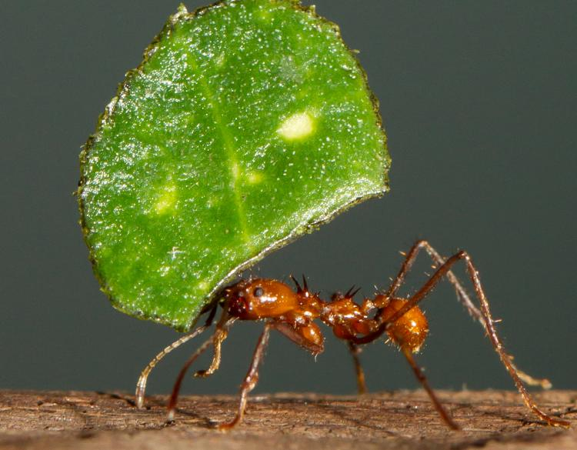

Microbial Ecology
Background | MAGs | Binning | Anvi’o | Questions
Notes:
Lots of cool environments/organisms to study microbial ecology. Highlight some of the Wisconsin study systems. Shout out to Suen lab for studying cute organisms

Slide 3
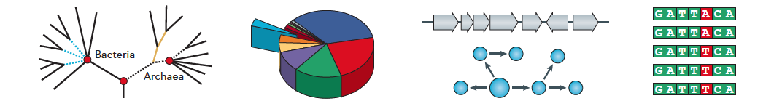
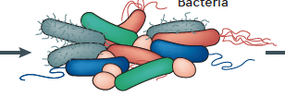
Microbial Ecology
Background | MAGs | Binning | Anvi’o | Questions
Notes:
In this field sometimes we want to go beyond taxonomical information obtained through 16S or amplicon sequencing that can get you information on what the main players are in the system and their relative abundance. But what about deeper studies such as genes/pathways in specific genomes, community composition, and strain variation studies
Phylogeny, Genes/pathways, Community composition, Strain variation studies

Slide 4
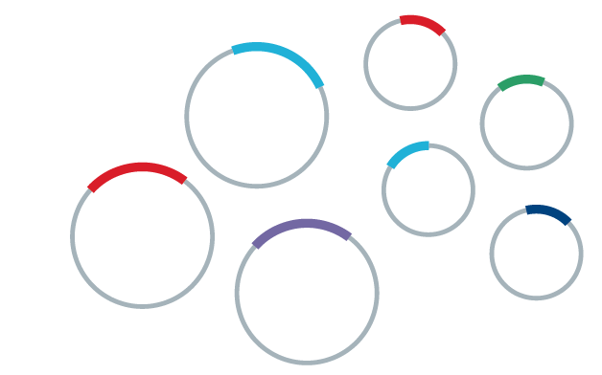
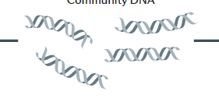
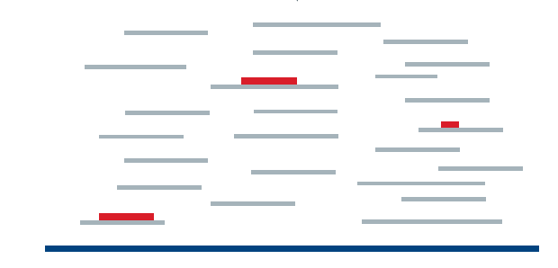
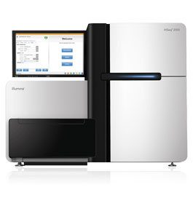
Metagenome Assembled Genomes
Background | MAGs | Binning | Anvi’o | Questions
Notes:
The main workflow to obtain metagenome assembled genomes (MAGs), also referred to as genomes from metagenomes (GFMs) MAGs is easier to say. Collect your samples from a particular environment, get the community DNA, and amplify the sequences and shear to short lengths so our current sequencing technologies can deal with the reads. You sequence and then assemble the reads back to a reference genome. This is a standard sequencing approach even if you are just sequencing a single genome or what have you. But when you have multiple genomes in a given environment …

Slide 5
Metagenome Assembled Genomes
Assembly and Mapping Processes
?
?
?
Background | MAGs | Binning | Anvi’o | Questions
Notes:
How do you know which individual short pieces go back to which genomes in your assembly/mapping processes. With any assembly process, the longer the read the better so you are certain of the genome of origin. With our current sequencing technologies however, shorter sequences obtained from shotgun sequencing are preferred. So how are you certain of the origin of the small pieces. After assembly you have short contigs, which is what you are binning.

Slide 6
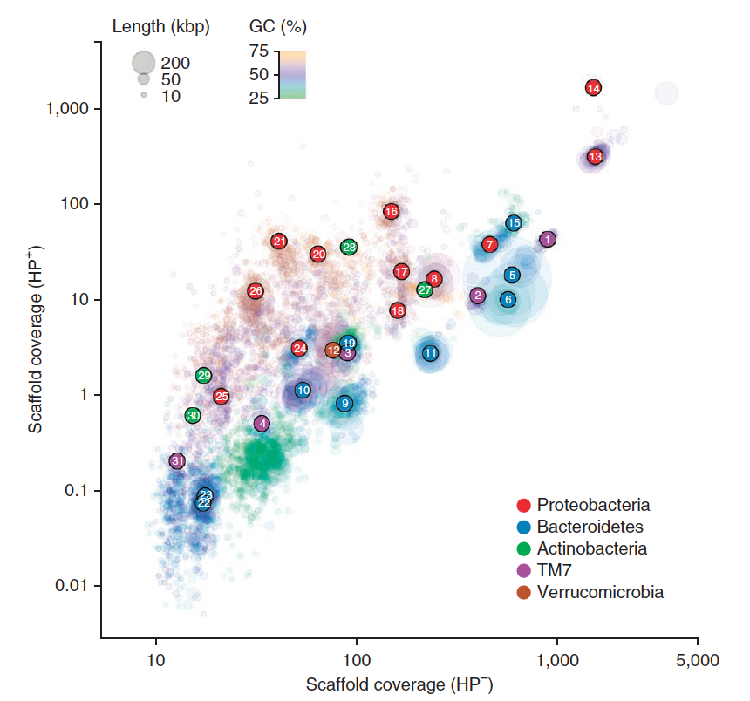
Binning
Place the sequence in the correct “bin” or OTU
- Composition based
- Differential Coverage based
Background | MAGs | Binning | Anvi’o | Questions
Notes:
Metagenomic binning is where you place the sequence to it’s corresponding bin or OTU, and these algorithms are based on sequence composition or differential coverage of an OTU. Think of this as sequence identifiers versus distribution patterns
TNF vs relative abundance/differential coverage

Slide 7
Composition Based Binning
Sequence signature k-mer (di-nucleotide, tetra-nucleotide) throughout the entire genome
Non-random
Non-linearly related to GC content
Tetranucleotide frequency (TNF) used to bin short reads to OTUs
Background | MAGs | Binning | Anvi’o | Questions

Slide 8
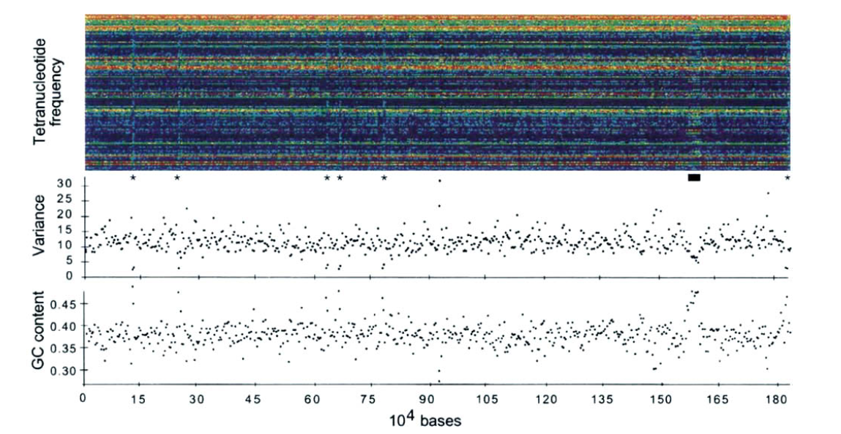
Noble et al. 1998
Background | MAGs | Binning | Anvi’o | Questions
Notes:
Determining the variability of long DNA sequences in microbial genomes. They computed tetranucleotide frequencies of sections of genomic DNA and converted those frequencies to color images and arranged those images according to genetic position. Tetranucleotide frequencies are highly conserved. Sections different are rRNA, bacteriophage, or undefined coding regions.
The order of nucleotides is a function of biases introduced during polymerase activities in DNA replication and repair. Certain oligos are preferred/avoided to optimize protein binding and codon mediate regulation of translation. Order of nucleotides can also be influenced by dinucleotdie stacking energies, curvature, and superhelicity of DNA. These processes maintain genetic stability by prescribing the order of nucleotides in bacterial genomes. Also influenced by mechanisms of genetic change – indels, transpositions. Alter the genetic composition and provide numerous possibilities for variation. Before this paper, people were trying to calculate the similaritiy of Dna/protein sequences to inform about evolution of genes. But nobody had really looked at long DNA sequences such as longer than 2.5 kb. Looking at longer sequences would help identify regions of genomes that are affected by mecahnisms of genetic change and the processes involved in maintaining genetic stability.
Oligonucleotide frequencies are used to compare regions with similar/dissimilar TNFs.
Similar = all regions, not from genetic exchange
Exogenously acquried DNA = dissimilar
Riboosomal RNA = conserved, similar
Variability of genomic DNA should be different among genetically unrelated bacteria = dissimilar evolutonary processes
Composite portrait = compute the TNF of sections of genomic DNA, convert the frequencies to color images, arrange images to genetic positions. Variance of TNFs in order to ID sections = dissimilar from other regions of the genome
Complete Haemophilus influenzae genome. Comparison of horizontal bands show that some TNFs consistently had low or high frequencies.
Low frequencies = purple
High frequnecies = yellow/orange/red
This genome has distinctly different TNFs, indictated by colors, than those of other regions.
What sticks out? Region between 156-159 = Mu like bacteriophage (---- bar)
Difference in fingerprints also in regions encoding rRNA = 12,24,63,66,77,181 (* marks)
Don’t show the other genomes, but there are distinctive fingerprints in all bacterial species. Visual differences not due high/low frequencies but due to changes in frequencies of many TNFs. Low variances and high GC values compared to rest of the genome. Maybe a relationship between fingerprints, variances of TNFs, and GC content
They postulate that differences in tetranucleotide frequencies are due to mechanisms of intercellular genetic exchange/processes that are involved in maintaining intracellular genetic stability. They were using this to inform evolution and plasticity of bacterial genomes how these sections are different from the rest of the genome.
The main take home point is that across the entire genome the TNF signatures are consistent and non-random, and can be used to piece short contigs back to a genome or bin.

Slide 9
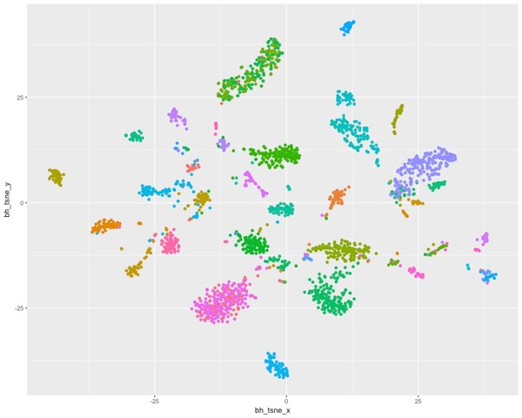
Background | MAGs | Binning | Anvi’o | Questions

Slide 10
Differential Coverage Based Binning
Relative Abundance
Samples
Background | MAGs | Binning | Anvi’o | Questions
Notes:
Coverage is identified as the number of reads mapping to a certain nucleotide position throughout the contig. Mapping reads based on coverage.

Slide 11
A Really, Really Crude Way to Think About This:
https://www.youtube.com/watch?v=DxbNRiH3ghc
Background | MAGs | Binning | Anvi’o | Questions
Notes:
Determining the variability of long DNA sequences in microbial genomes. They computed tetranucleotide frequencies of sections of genomic DNA and converted those frequencies to color images and arranged those images according to genetic position. Tetranucleotide frequencies are highly conserved. Sections different are rRNA, bacteriophage, or undefined coding regions.
The order of nucleotides is a function of biases introduced during polymerase activities in DNA replication and repair. Certain oligos are preferred/avoided to optimize protein binding and codon mediate regulation of translation. Order of nucleotides can also be influenced by dinucleotdie stacking energies, curvature, and superhelicity of DNA. These processes maintain genetic stability by prescribing the order of nucleotides in bacterial genomes. Also influenced by mechanisms of genetic change – indels, transpositions. Alter the genetic composition and provide numerous possibilities for variation. Before this paper, people were trying to calculate the similaritiy of Dna/protein sequences to inform about evolution of genes. But nobody had really looked at long DNA sequences such as longer than 2.5 kb. Looking at longer sequences would help identify regions of genomes that are affected by mecahnisms of genetic change and the processes involved in maintaining genetic stability.
Oligonucleotide frequencies are used to compare regions with similar/dissimilar TNFs.
Similar = all regions, not from genetic exchange
Exogenously acquried DNA = dissimilar
Riboosomal RNA = conserved, similar
Variability of genomic DNA should be different among genetically unrelated bacteria = dissimilar evolutonary processes
Composite portrait = compute the TNF of sections of genomic DNA, convert the frequencies to color images, arrange images to genetic positions. Variance of TNFs in order to ID sections = dissimilar from other regions of the genome
Complete Haemophilus influenzae genome. Comparison of horizontal bands show that some TNFs consistently had low or high frequencies.
Low frequencies = purple
High frequnecies = yellow/orange/red
This genome has distinctly different TNFs, indictated by colors, than those of other regions.
What sticks out? Region between 156-159 = Mu like bacteriophage (---- bar)
Difference in fingerprints also in regions encoding rRNA = 12,24,63,66,77,181 (* marks)
Don’t show the other genomes, but there are distinctive fingerprints in all bacterial species. Visual differences not due high/low frequencies but due to changes in frequencies of many TNFs. Low variances and high GC values compared to rest of the genome. Maybe a relationship between fingerprints, variances of TNFs, and GC content
They postulate that differences in tetranucleotide frequencies are due to mechanisms of intercellular genetic exchange/processes that are involved in maintaining intracellular genetic stability. They were using this to inform evolution and plasticity of bacterial genomes how these sections are different from the rest of the genome.
The main take home point is that across the entire genome the TNF signatures are consistent and non-random, and can be used to piece short contigs back to a genome or bin.

Slide 12
Binning Algorithms
Different Algorithms take different parameters into account:
CONCOCT: Sequence composition and coverage (Alneberg et al 2013)
Ray Meta: k-mer frequencies (Boisvert et al. 2012)
MetaVelvet: extended from single genome assembler Velvet – k-mer connectivity and then coverage difference
Albertson et al (unnamed binning workflow): differential abundance and then k-mer frequencies
SPAdes: considers pairs of k-mers (k-bimers), developed for single cell sequencing (Bankevich 2012)
Background | MAGs | Binning | Anvi’o | Questions

Slide 13
Completeness vs. Redundancy
Completeness = # of single copy genes found
# of single copy genes searched for
Redundancy = # of single copy genes found more than once
# of single copy genes searched for
Background | MAGs | Binning | Anvi’o | Questions

Slide 14
Completeness vs. Redundancy
Completeness = 100 = ~ 72 % complete
139
5
Redundancy = = ~ 3.6 %
139
Background | MAGs | Binning | Anvi’o | Questions

Slide 15


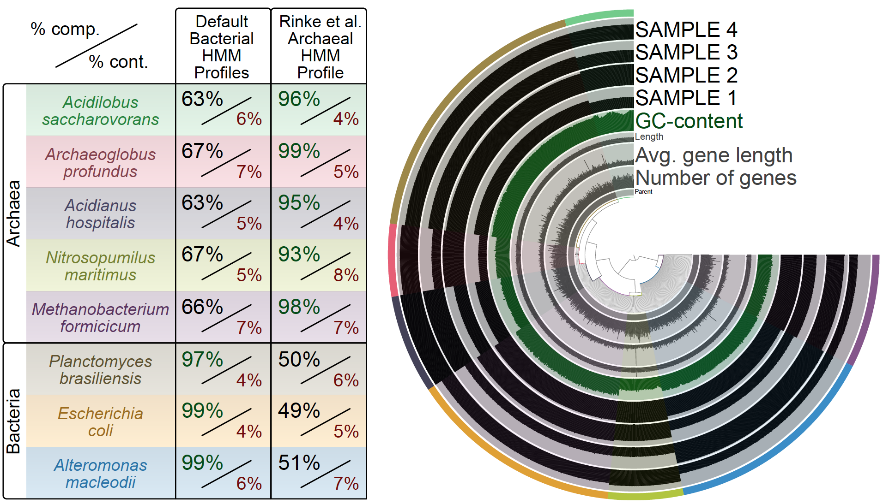
Anvi’o
Completeness/contamination estimates by manually curating your bins
Background | MAGs | Binning | Anvi’o | Questions

Slide 16
Single Copy Core Genes
To estimate completeness, the contigs are scanned using previously published bacterial/archaeal single-copy collections
Running this script utilizes bacterial/archaeal HMM profiles in the codebase (Campbell et al 2013, Rinke et al. 2013)
From this point, you can refine your bins within anvi-summarize and anvi-refine to add a “human guided” aspect to your binning workflow
Background | MAGs | Binning | Anvi’o | Questions

Slide 17
Questions?
Background | MAGs | Binning | Anvi’o | Questions

